Slide 1
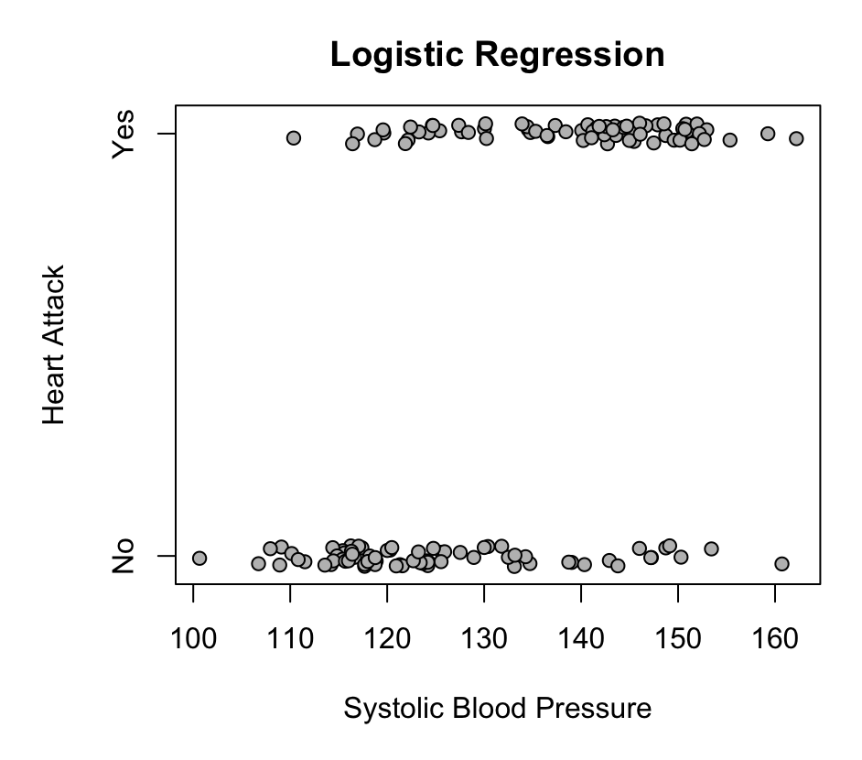

Slide 2
Response is categorical.
Could be modeled with a Bernoulli
Ask “How does p_{i} change with blood pressure?
Need a way to model the probability of a heart attack as a function of blood pressure.

Slide 3
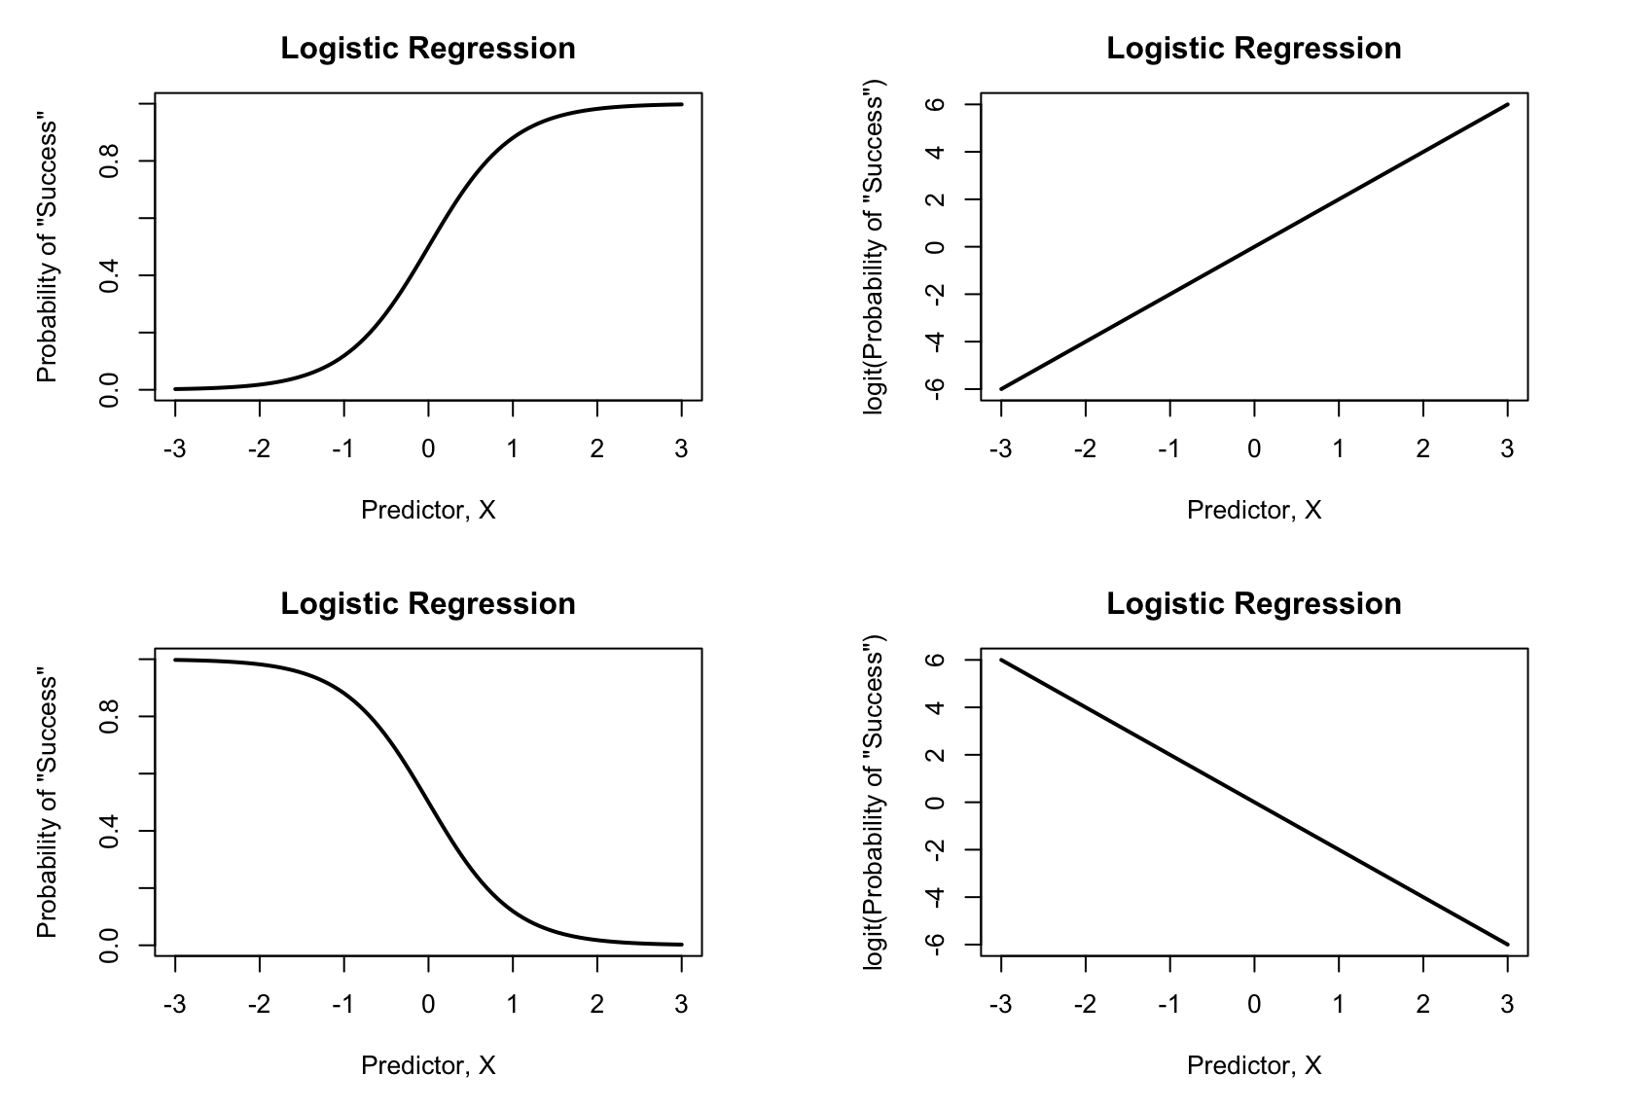
The logit transform
Logit function
Transforms values in [0,1] to (-∞,∞)
“Log-odds”
Inverse logit function

Slide 4
Logistic regression uses the logit transform
Logistic regression moves non-linear problems (modeling probability) to a linear problem.

Slide 5
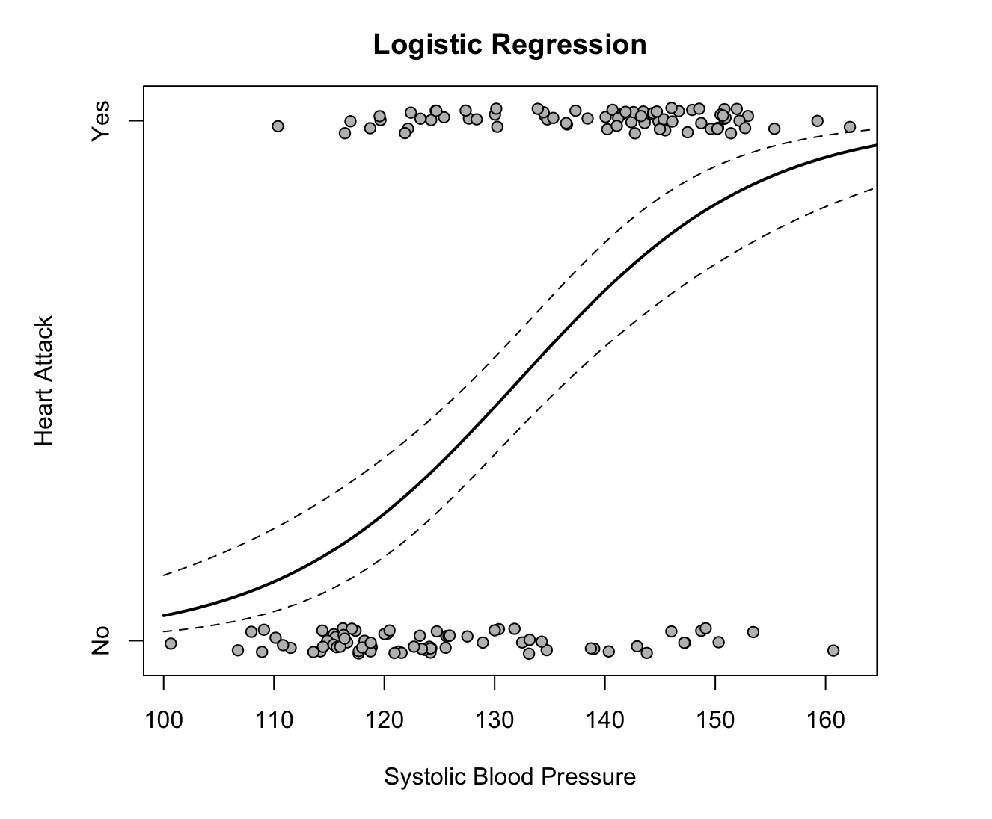
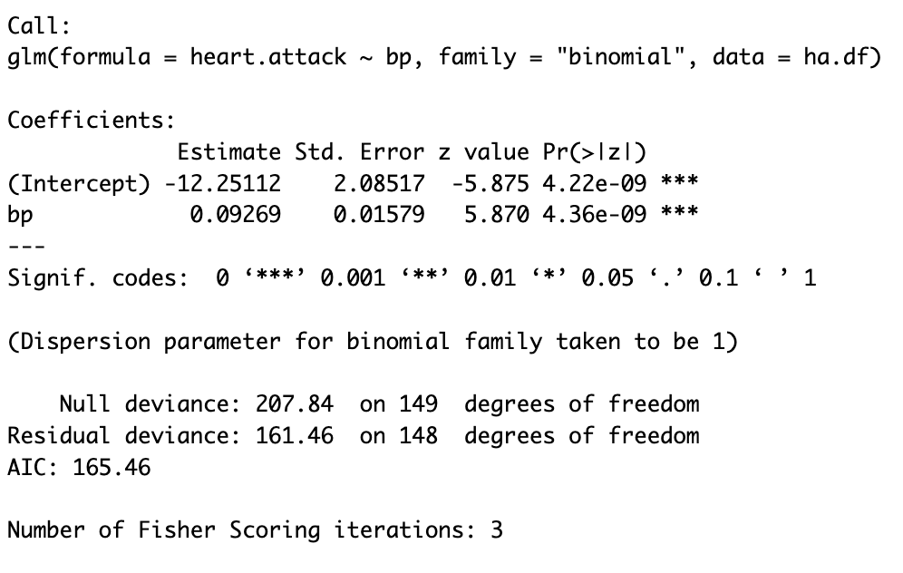
Logistic regression in R
What do these things mean?

Slide 6
Interpreting logistic regression coefficients
Intercept = log-odds probability of heart attack when blood pressure is 0
Another way:
Log-odds probability of heart attack at average blood pressure
Slope = How much the log-odds change with a unit increase in blood pressure.
For heart attacks, we have mean Y = -0.057
Pr(Heart attack| Average Blood Pressure) = 0.486

Slide 7
Interpreting the slope as an odds ratio
Odds ratios give how much the odds of an event change in comparison with some baseline.
The slope gives the change in log-odds when the predictor changes by one unit.
Slope estimate = 0.093
OR = e^{0.093} ≈ 1.1
Odds of a heart attack increase by 10% for every unit increase in blood pressure (1.1 = 110% -> 110% - 100% = 10% increase)

